Slide 1
MC Control with Epsilon Greedy Policies: Wall-Following Example
Ali Emami

Slide 2
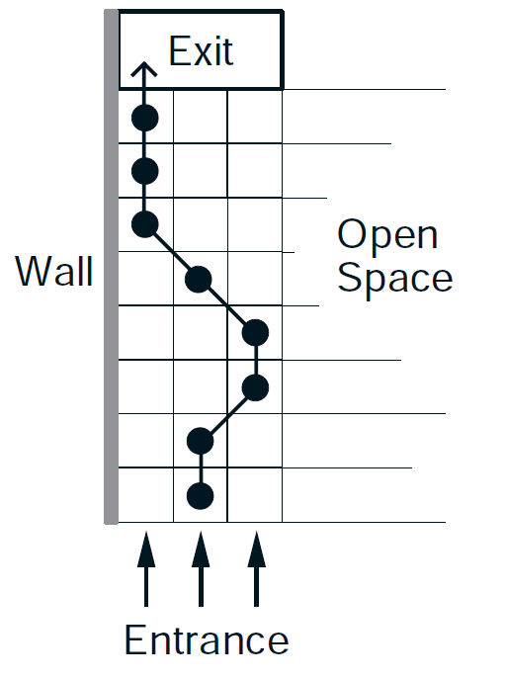
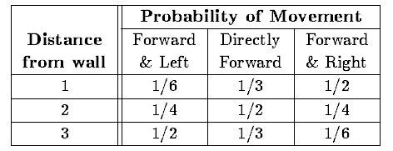
Actions: Forward-Left, Forward-Straight, Forward-Right
Rewards:
-0.2 in cell 1, 0 in cell 2, -0.2 in cell 3,
Terminal states: 1 if reach exit, -1 if hit wall, -1 if enter open space Start: Randomly at one of the first three entrance states
Random policy
Forward Straight policy
“Built-in” policy:
Figure from Sutton, Richard S. "TD models: Modeling the world at a mixture of time scales." ICML. Vol. 12. 1995.

Slide 3
Monte Carlo Policy Control
Monte Carlo (MC) methods learn directly from experience through environment. Episode of experience captured by a series of State-Action-Reward-Next State-tuple.
We sample episodes and update our estimate at the end of each episode. MC has high variance (many random decisions) but is unbiased.
MC Policy Evaluation: State-value function V(s) is estimated given a policy. Episodes of experience are sampled and V(s) is estimated as the reward received averaged across all of your experience. Works for action value function Q(s,a) as well. Convergence is proven given enough samples.
MC Control: MC Policy Evaluation is used to evaluate the current policy an improve it greedily.
How do we ensure all states explored without having a full model of the environment?
Use epsilon-greedy policies instead of fully greedy.

Slide 4
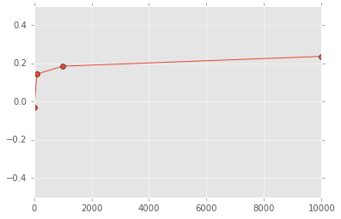
Varying Number of Episodes
Mean Total Reward
Number of Episodes

Slide 5
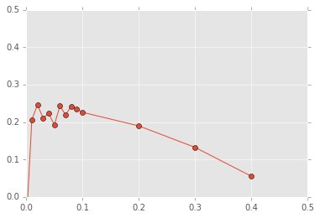
Varying Epsilon in Wall-Following Example (5000 episodes, discount factor=0.9)
Mean Total Reward
Epsilon (probability of random choice)

Slide 6
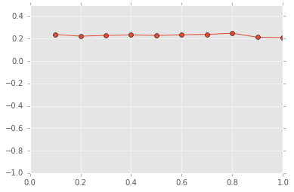
Varying Discount Factor (5000 episodes)
Mean Total Reward
Discount Factor
Why constant?

Slide 7
Comparison of Resulting Policy from MC Control (with best parameters) vs Baseline Policies, testing on 10,000 episodes
 | Random Policy | Built-in Policy | Forward-Straight Policy | MC Control Policy
Mean Total Reward | -1.081 | -0.486 | -0.063 | 0.251
policy(0)=[0.01666667 , 0.01666667, 0.96666667]
policy(1)=[0.01666667, 0.96666667, 0.01666667]
policy(2)=[0.96666667, 0.01666667, 0.01666667]

Slide 8
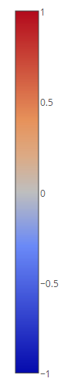
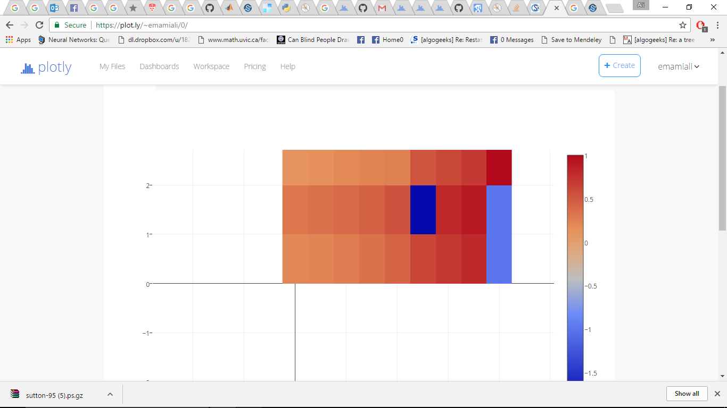

V_{π}(S) for Best Policy
Hit Wall
Open Space
Reach Exit

